Slide 1
Outline Of Today’s Discussion
Monocular & Binocular Depth Cues: Understanding Retinal Disparity

Slide 2
Part 1
Monocular & Binocular Depth Cues:
Understanding Retinal Disparities

Slide 3
Monocular Depth Cues
A fundamental problem in perception: How do we recover a 3-d world from a 2-d retinal image?
A Monocular Depth Cue is information about depth (i.e., relative position along the “Z” axis) that is available even in just one eye’s view.

Slide 4
Retinal Disparities
For the average adult human, the two eyes are horizontally displaced from each other by ~6.5 cm. (My inter-pupilary distance is 6.8 cm.)
Because the two eyes view the world from slightly different positions, there are positional differences in the images projected to the two retinas.
These positional differences would also be found in photos from two cameras that shoot from slightly different horizontal positions….

Slide 5
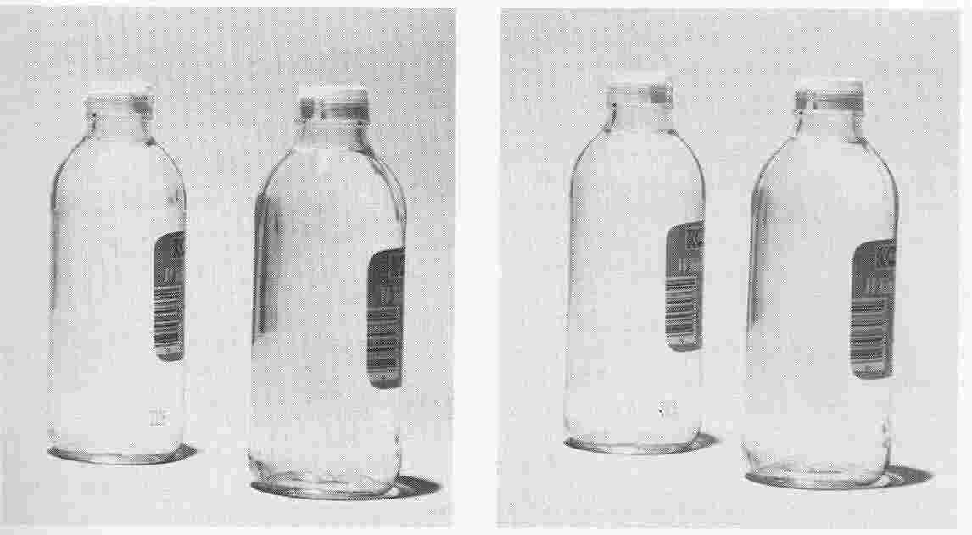
Retinal Disparities
Photos from two laterally displaced cameras.

Slide 6
Retinal Disparities
Photos from two laterally displaced cameras.
The gap in the left image differs
from the gap in the right image.

Slide 7
Retinal Disparities
The difference between the gaps in the left and right images would occur if the right bottle were nearer than the left bottle.
Let’s see a new pair of images in which an inter-ocular difference specifies depth….

Slide 8
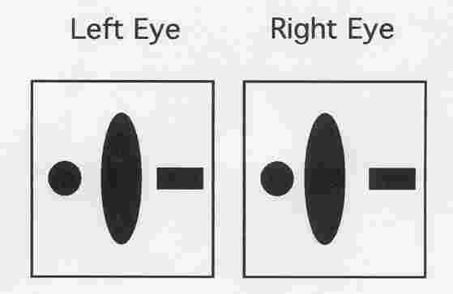
Retinal Disparities
This is the top of page 1 in your hand-out.
Let’s try to “Free Fuse” - to combine
these two images w/o using an optical device

Slide 9
Retinal Disparities
Place the index card between the images.
This allows the left image to stimulate the left eye,
and the right image to stimulate the right eye.

Slide 10
Retinal Disparities
Let your eyes relax (uncross).
The two images will slide together perceptually,
and the central oval will appear “nearer” in depth.

Slide 11
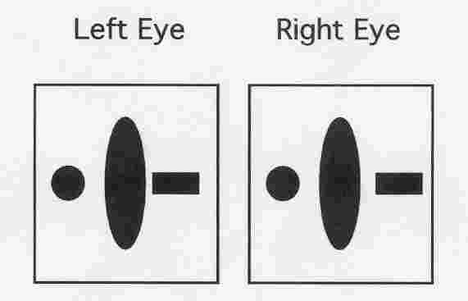
Retinal Disparities
See The Hand-out: Bottom Image
More Free Fusing Practice
What do you see?

Slide 12
Retinal Disparities
Note: When S&P geeks go on vacation,
they take two photos of everything (6.5 cm apart).
They then “free fuse” the photos, which contain lateral
separations that generate 3D views of their vacation!

Slide 13
Retinal Disparities
The lateral separation between objects as seen by the left eye and by the right eye is called Retinal Disparity.
The perception of depth that arises solely from retinal disparity is called Stereopsis (“solid vision”).
Let’s see the geometry that gives rise to retinal disparities, and stereopsis. It starts with where our eyes are fixated…

Slide 14
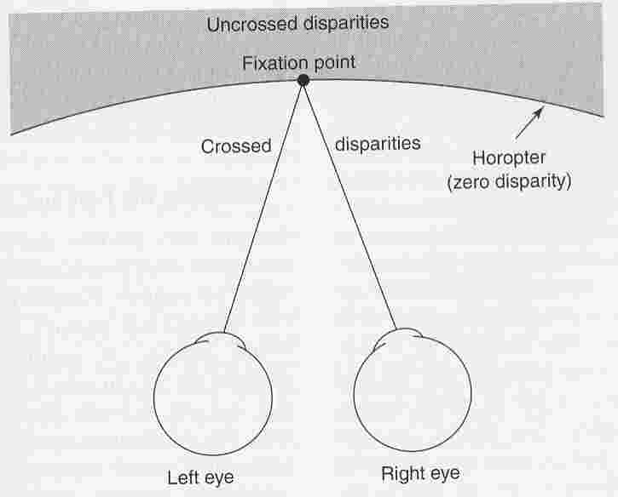
Retinal Disparities
The horopter is the plane of fixation.
The Horopter is the Plane of Zero Disparity.

Slide 15
Retinal Disparities
The Horopter is the Plane of Zero Disparity.
Remember:
light travels
in straight
lines.
All objects on the horopter project to
corresponding retinal points.

Slide 16
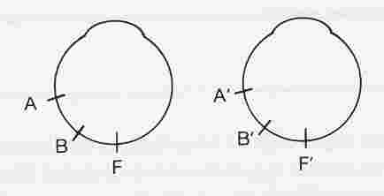
Retinal Disparities
Corresponding Retinal Points = Zero Disparity
To determine corresponding retinal points,
“slide” one eye on top of the other.

Slide 17
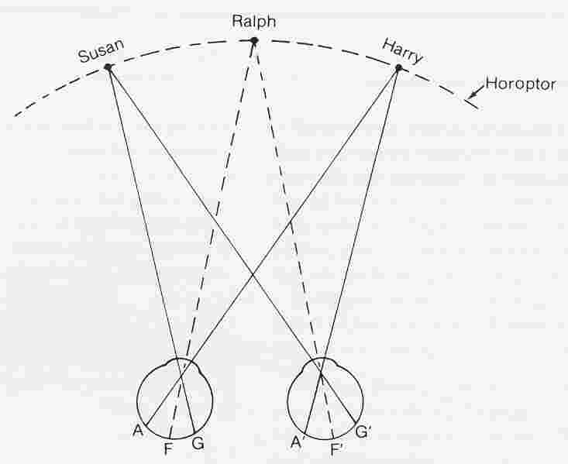
Retinal Disparities
Sue, Ralph & Harry are on the horopter,
therefore, each projects to corresponding points
(“rotate” and “slide” the eyes on top of each other).

Slide 18
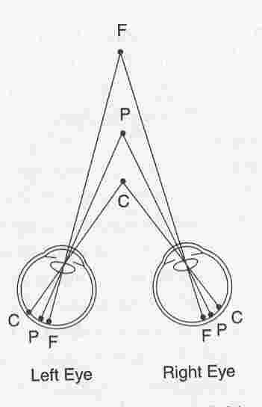
Retinal Disparities
If the fixation point is “P”
Then point “C”, which is closer than fixation,
projects to non-corresponding points in the two retinas.

Slide 19
Retinal Disparities
All points closer than fixation generate “crossed” disparities.
Point “C” generates
crossed disparities.
You’d have to cross your eyes to look at the closer object,
i.e., to change fixation from “P” to “C”.

Slide 20
Retinal Disparities
All points further than fixation generate “uncrossed” disparities.
Point “F” generates
uncrossed disparities.
You’d have to uncross your eyes to look at the further object,
i.e., to change fixation from “P” to “F”.

Slide 21
Retinal Disparities
Summary of Viewing Geometry
Points further
than fixation
generate
uncrossed
disparities.
Points nearer
than fixation
generate
crossed
disparities.
Objects on the horopter project to
corresponding retinal points (zero disparity).

Slide 22
Retinal Disparities
Disparities are ‘crossed’ when the left-eye’s view has rightward displacements, and the right-eye’s view has leftward displacements. (That is, everything is “crossed”, i.e., backwards!)
Disparities are ‘uncrossed’ when the left-eye’s view has leftward displacements, and the right-eye’s view has rightward displacements. (That is, everything is the way it “should be”!)
Here are some questions to help you understand crossed & uncrossed disparities…

Slide 23
Retinal Disparities
Potential Pop Quiz Question
These Images Contain No Binocular Disparity
What change to the left image would make
the circle appear near in depth?

Slide 24
Retinal Disparities
Potential Pop Quiz Question
These Images Contain No Binocular Disparity
What change to the right image would make
the triangle appear far in depth?

Slide 25
Retinal Disparities
Potential Pop Quiz Question
These Images Contain No Binocular Disparity
Describe two different ways of making the
the cross appear near in depth?

